Slide 1

Introduction to Linux
Introduction to Linux World, Virtualization And Linux Console
SoftUni Team
Technical Trainers
Software University
https://softuni.bg

Slide 2

Table of Contents
Introduction to Linux
Why Linux and Linux System Architecture
Linux Ecosystem and Distribution Families
Linux Certifications
Introduction to Virtualization
Getting to know VirtualBox
Introduction to Linux Console
First Steps on the Console

Slide 3
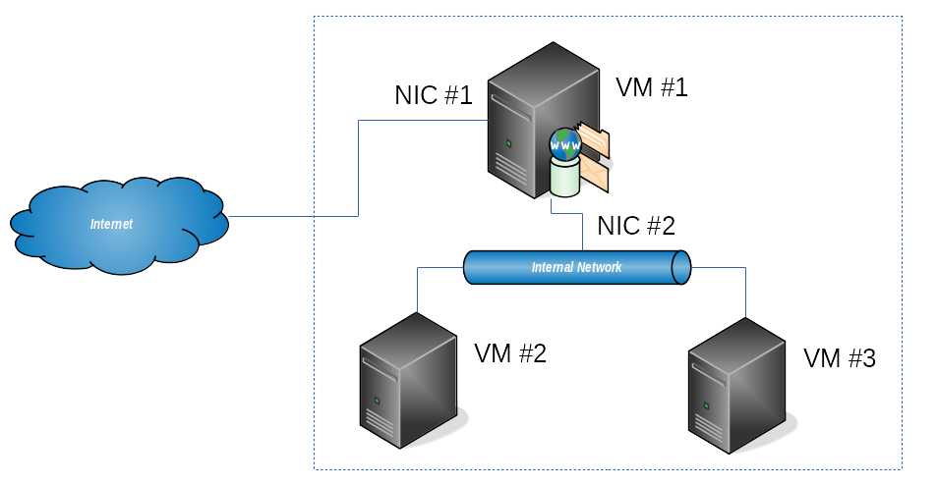
Lab Infrastructure

Slide 4
Introduction to Linux
Why? Where? What is (Not)?

Slide 5
Why Linux?
It is a phenomenon
Went all the way from a student's hobby to world domination
Internet runs on Linux
Operating system for over 95% of the top one million domains *
It runs on 100% of the top 500 supercomputers **
There is huge demand for Linux skills
It is both challenging and fun
* https://www.linuxfoundation.org/about
** https://www.top500.org/statistics/details/osfam/1

Slide 6
Where is Linux?
Every aspect of our life
Server rooms and data centers
Home and office
Business and government
Spacecraft and regular transportation
Hospitals, scientific and medical laboratories
Devices of any size
From tiniest devices, trough PCs, servers, and supercomputers
EVERYWHERE

Slide 7
What is (Not) Linux?
It is NOT the complete OS, it is just the Kernel
Often the term is used to refer to the whole OS
A Linux-based system is a modular Unix-like operating system
Linux kernel is a monolithic kernel

Slide 8
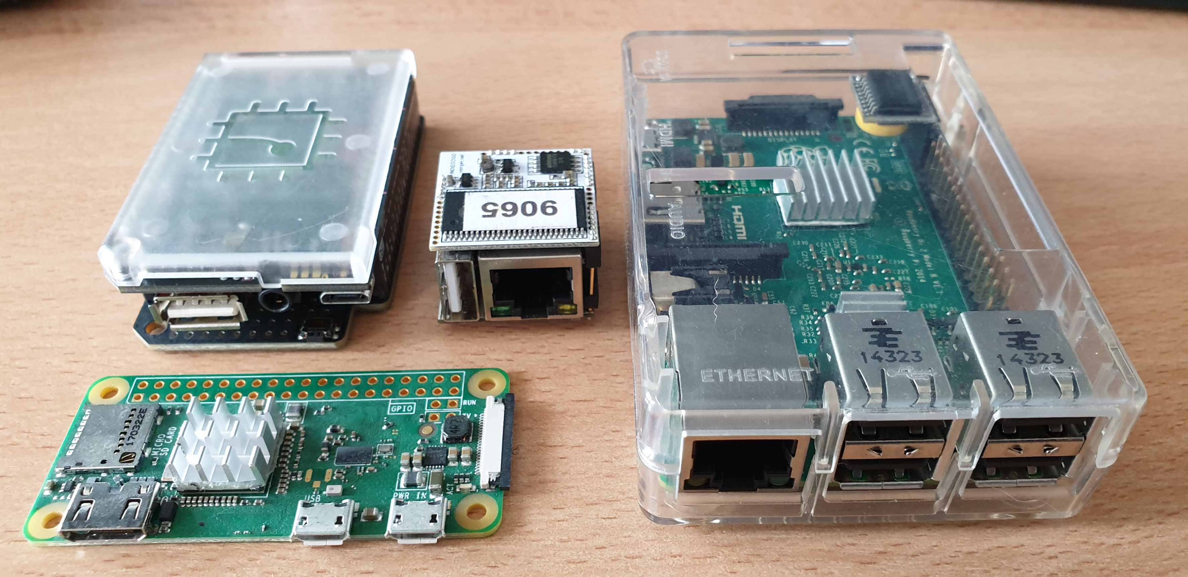
Tiny Linux Computers
C.H.I.P.
Raspberry Pi
1/2/3/4
VoCore
Raspberry Pi
Zero

Slide 9

Linux System Architecture
Building Blocks and Definitions

Slide 10
Linux Definitions
Kernel
The core of the OS and manages the hardware
Process
The running programs that the kernel manages
Kernel Space
The area of memory that only the kernel can access
User Space
The main memory allocated by the kernel for user processes

Slide 11
Linux Users and Groups
Users
Entity that can run processes and owns files
Support permissions and boundaries
Superuser (root), system users, and regular users
Groups
Set of users
Users in a group can share file access

Slide 12
Linux System Architecture
Linux System
User Processes
GUI
Shell
Services
Linux Kernel
System Calls / Functions
Memory Management
Process Management
Device Drivers
Hardware
CPU
RAM
HDD
NET
…

Slide 13
Linux Graphical Environment
Applications
Desktop environment (KDE, GNOME, XFCE, …)
Windows decoration
Window manager (WindowMaker, sawfish, fvwm, …)
Login manager
Display manager (GDM, KDM, XDM, …)
I/O devices
Display server (Xorg, XFree86, X11, …)

Slide 14
Linux Distribution
System components
Boot Loader
Boot Manager
Kernel
User components
Daemons
Shell
Graphical Environment
User Applications
Documentation and Support
Applications
Support
Daemons
Shell
GUI
Docs &
Guides
Kernel
Boot Manager
Boot Loader

Slide 15
Distribution Families
Criteria. Families. Our Choice

Slide 16
Family Criteria and Specifics
Criteria
Share the same code base
Same package format and package management system
Members are derivatives
Specifics
Different Release / Life cycles
Different purpose
Community / Commercial support
Upstream
Downstream

Slide 17



Distribution Families – Debian
Debian (https://www.debian.org/)
Knoppix (http://www.knoppix.org/)
Kali Linux (https://www.kali.org/)
Deepin (https://www.deepin.org/en/)
SteamOS (http://store.steampowered.com/steamos/)
Ubuntu (https://www.ubuntu.com/)
KUbuntu, LUbuntu, XUbuntu
Linux Mint (https://linuxmint.com/)
ElementaryOS (https://elementary.io/)

Slide 18



Distribution Families – Fedora **
Fedora (https://getfedora.org/)
Red Hat Enterprise Linux (https://www.redhat.com/en)
CentOS (https://www.centos.org/)
Oracle Linux (https://www.oracle.com/linux/)
Scientific Linux* (http://scientificlinux.org/)
** The situation has changed. Now there is CentOS Stream which will act as the upstream distribution

Slide 19

Distribution Families – OpenSUSE
openSUSE Tumbleweed
openSUSE Krypton*
openSUSE GNOME Next*
openSUSE Leap
openSUSE Argon*
Gecko Linux (https://geckolinux.github.io/)
SUSE Linux Enterprise (https://www.suse.com/)
https://www.opensuse.org/
* Distributions for enthusiasts and developers that want to test the latest possible software

Slide 20



Distribution Families – Others
Mandriva Linux (ex-Mandrake, discontinued)
OpenMandriva (https://www.openmandriva.org/)
Mageia (https://www.mageia.org/en/)
PCLinuxOS (https://www.pclinuxos.com/)
ROSA Linux (http://www.rosalab.com/)
Arch Linux* (https://www.archlinux.org/)
Gentoo* (https://www.gentoo.org/)
Slackware* (http://www.slackware.com/)
* They have their own families with derivative distributions

Slide 21
Our Distributions of Choice
CentOS, openSUSE Leap, and Ubuntu
Reasons
Part of an enterprise supported families
Huge install base
Often seen (their enterprise siblings) in job announcements
Certification tracks
Alternatives – explore https://distrowatch.com/ for more

Slide 22
How to Obtain Linux Distribution
Free to download and redistribute
Download options
Direct download using HTTP / FTP usually from the closest mirror
Torrents (are good)
Download artefacts
Live media or install media (CD / DVD / USB)
Different size (net, minimal, standard, everything, …)
Different purpose (server, desktop, workstation, …)
Different architecture (i386, x86_64, aarch64, …)

Slide 23
A Word On Versions and Release Cycles
Release cycles
Version-based distributions have new release on a fixed term and there is a change in either the minor or major version number
Rolling distributions do not have versions at all and there is no schedule for new releases
Versions
Some have single version number, while others have major and minor
Support period
Long term support (LTS) versions are supported for 3, 5, or more years
Short term support (STS) versions are supported usually until the next release or some time after that
Fedora 32
Ubuntu 20.04

Slide 24
Linux Ecosystem
Regulations and Organizations

Slide 25
Linux Regulations
Linux Standard Base (LSB)
Purpose: Standardize the software system structure
Maintainer: The Linux Foundation
URL: https://refspecs.linuxfoundation.org/lsb.shtml
Version: 5.0
File System Hierarchy Standard (FHS)
Purpose: Defines the directory structure and directory contents
Maintainer: The Linux Foundation
URL: https://refspecs.linuxfoundation.org/FHS_3.0/fhs/index.html
Version: 3.0

Slide 26
(Some) Major Organizations in Linux World
Free Software Foundation (FSF)
Mission: Promotes computer user freedom. Sponsors GNU
URL: http://www.fsf.org/
The Linux Foundation
Mission: Project incubator. Performance based certifications
URL: https://www.linuxfoundation.org/
Linux Professional Institute (LPI)
Mission: Distribution agnostic certifications
URL: http://lpi.org/

Slide 27

Professional Certifications
Authorities. Levels. Requirements

Slide 28
Introduction to Professional Certifications
Authorities
LPI, CompTIA, Linux Foundation, Red Hat, SUSE, Oracle, …
Categories
By Validity – Lifetime, Fixed Term, or Fixed Version
By Distribution – Agnostic or Not
By Type – Question (test) based or Performance based
By Place – At home or at an Exam center
By number of exams

Slide 29
Linux Professional Institute (LPI)
LPI Linux Essentials
Entry level lifetime certificate
Distribution agnostic, question based, 1 exam (010-160)
LPIC-1: Linux Administrator
Associate level certificate with 5 years validity
Distribution agnostic, question based, 2 exams (101/102-500)
LPIC-2: Linux Engineer – 5 years, 2 exams (201/202-450)
LPIC-3: Linux Enterprise Professional – 5 years, 3 types, 1 ex/t
http://www.lpi.org/our-certifications/summary-of-certifications

Slide 30
LPI Linux Essentials
Five topics
The Linux Community and a Career in open source
Finding Your Way on a Linux System
The Power of the Command Line
The Linux Operating System
Security and File Permissions
40 multiple-choice questions in 60 minutes
Lifetime Validity
http://www.lpi.org/our-certifications/exam-010-objectives

Slide 31
CompTIA Linux+ (XK0-004)
Five domains
Hardware and System Configuration
System Operations and Maintenance
Security
Linux Troubleshooting and Diagnostics
Automation and Scripting
Associate level certificate with expiration (3 years) and renewal option
Distribution agnostic, question based, 1 exam (90 questions for 90 minutes)
https://certification.comptia.org/certifications/linux

Slide 32
Linux Foundation
LFCA: Linux Foundation Certified IT Associate
Pre-professional certificate valid for 3 years
Distribution agnostic, test based, 1 exam
LFCS: Linux Foundation Certified Sysadmin
Associate level certificate valid for 2 years
Distribution specific, performance based, 1 exam
LFCE: Linux Foundation Certified Engineer
Professional level certificate valid for 2 years
Distribution specific, performance based, 1 exam
https://training.linuxfoundation.org/certification

Slide 33
Red Hat
Red Hat Certified System Administrator (RHCSA)
Associate level certificate valid for 3 years
Distribution specific, performance based, 1 exam
Red Hat Certified Engineer (RHCE)
Professional level certificate valid for 3 years
Distribution specific, performance based, 1 exam
Red Hat Certified Architect (RHCA)
https://www.redhat.com/en/services/certifications

Slide 34
SUSE
SUSE Certified Administrator (SCA)
Associate level certificate, lifetime validity, version based
Distribution specific, test based, 1 exam
SUSE Certified Engineer (SCE)
Professional level certificate, lifetime validity, version based
Distribution specific, test based, 1 exam
SCA+ in SUSE Linux Enterprise High Availability
https://training.suse.com/certification/

Slide 35
Oracle
Associate and Professional level certificates
Oracle Certified Associate, Oracle Linux 5 and 6 System Administrator
Oracle Certified Professional, Oracle Linux 6 System Administrator
Oracle Certified Professional, Oracle Linux 8 System Administrator
Lifetime validity, version based
Distribution specific, test based, 1 exam
https://education.oracle.com/oracle-certification-path/product_295

Slide 36

It's Time For a Break
Back in 10 Minutes

Slide 37

Introduction to Virtualization
Fundamental Principles and Use Cases

Slide 38
What is Virtualization?
Virtualization is the act of creating a software-based or virtual (rather than physical) version of something
Main definitions
Host OS (machine)
Virtual machine
Guest OS (machine)
Guest additions
VM
VM
Guest OS
(machine)
Guest OS
(machine)
Additions
Additions
Host OS
(machine)

Slide 39
Hypervisors
A hypervisor or virtual machine monitor (VMM) is computer software, firmware, or hardware, that creates and runs virtual machines
VM
VM
Guest OS
Guest OS
VM
VM
Guest OS
Guest OS
Additions
Additions
Additions
Additions
Hypervisor
Hypervisor
Host OS
Hardware
Hardware
Type 1 (bare metal)
Type 2 (hosted)

Slide 40
Use Cases
Infrastructure consolidation
Better usage and utilization of the available hardware
Maintain separate environments
For example – development, test, production
Testing and evaluation
Test a newer software version or evaluate a product
High availability and disaster recovery

Slide 41
Our Case
We would like to
Install multiple machines on limited hardware resources
Manage their isolation
Manage their state – our own time-machine
Move, export, and import them
Clone them – create multiple copies out of one master
The answer is Virtualization

Slide 42
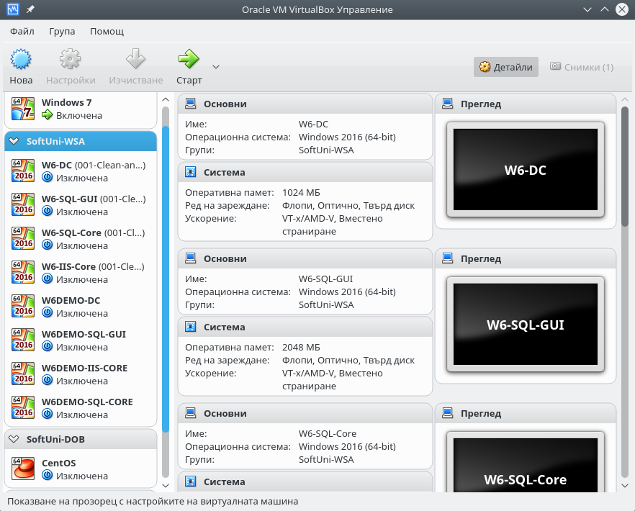
Oracle VirtualBox
Cross-platform
Broad guest OS support
Easy to install
Simple GUI
Automation options
Free

Slide 43
A Note on Virtualization
Yes, there are many options. Some of them are:
Oracle VirtualBox
VMware Workstation (Player / Pro) / VMware Fusion (Player)
Hyper-V
VMware ESXi
You can experiment with all of them and select the one you like
Be sure that there is only one installed at any given moment
Basic principles and actions are the same no matter the tool

Slide 44
Getting to Know VirtualBox
Main Functionalities, Usage Scenarios

Slide 45
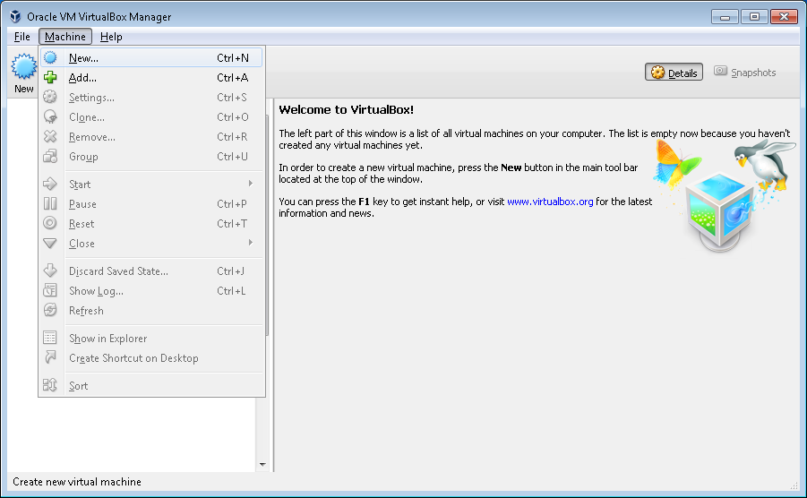
Problem: New Virtual Machine
Create a new virtual machine
Set correct parameters
Avoid overcommit
Provision hardware

Slide 46
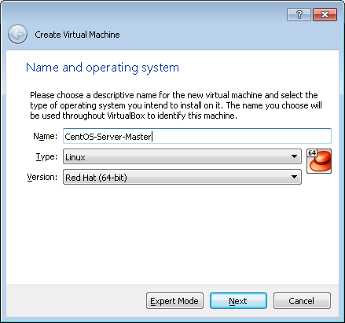
Solution: New Virtual Machine
Enter name, type, and version

Slide 47
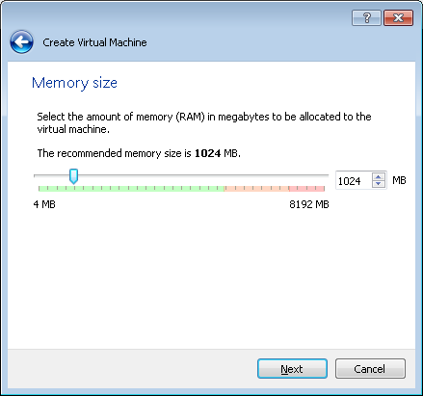
Solution: New Virtual Machine
Select memory size

Slide 48
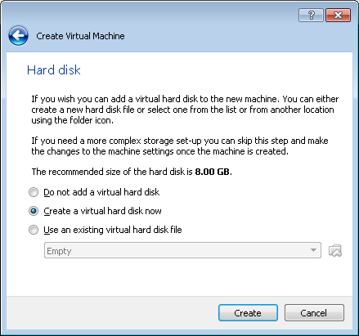
Solution: New Virtual Machine
Select existing or create new disk

Slide 49
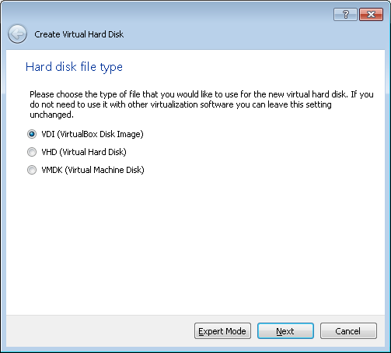
Solution: New Virtual Machine
Select new disk type

Slide 50
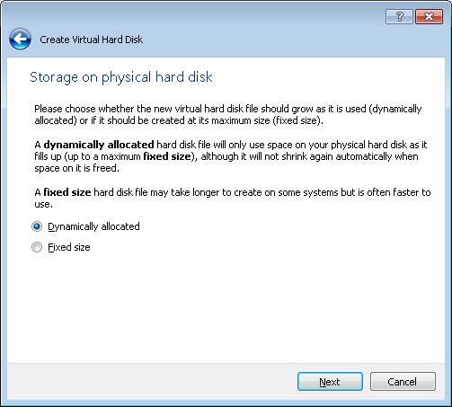
Solution: New Virtual Machine
Select disk space allocation mechanism

Slide 51
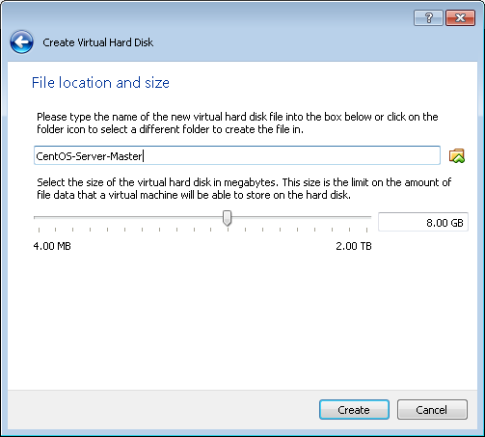
Solution: New Virtual Machine
Select disk location and size

Slide 52
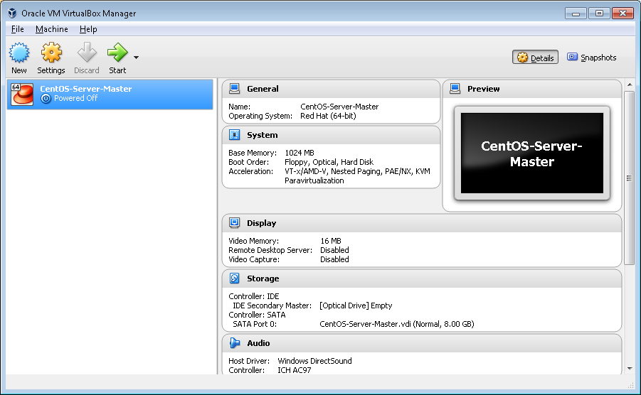
Solution: New Virtual Machine
Our new virtual machine is created

Slide 53
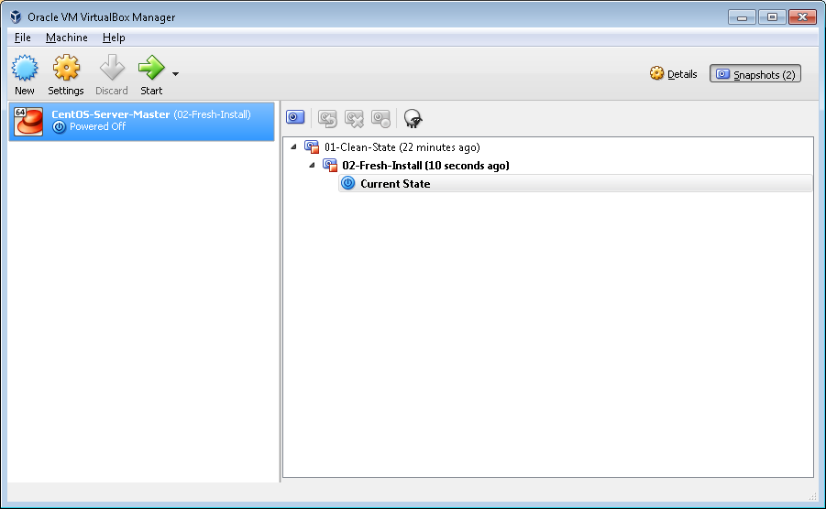
Problem: Track Changes in a VM
Move through machine states
Save current state
Return to a previous state
More than one branch

Slide 54
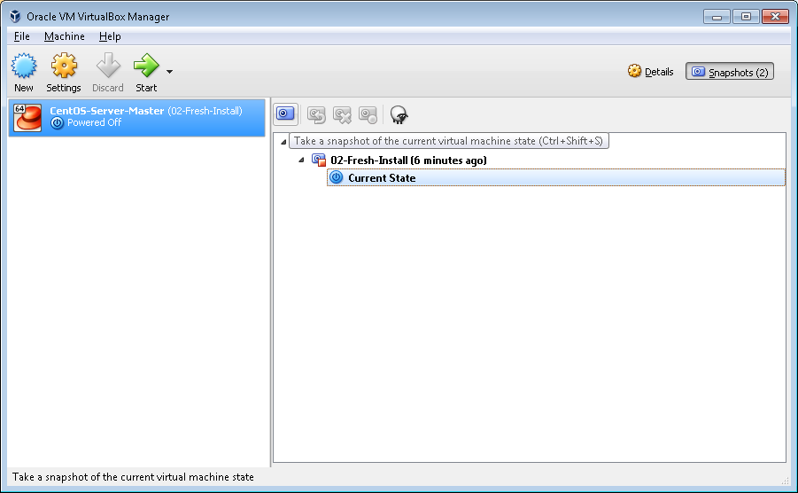
Solution: Track Changes in a VM
Create snapshot

Slide 55
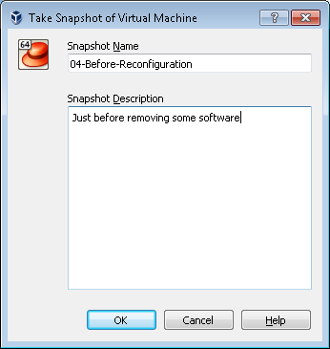
Solution: Track Changes in a VM
Enter snapshot details

Slide 56
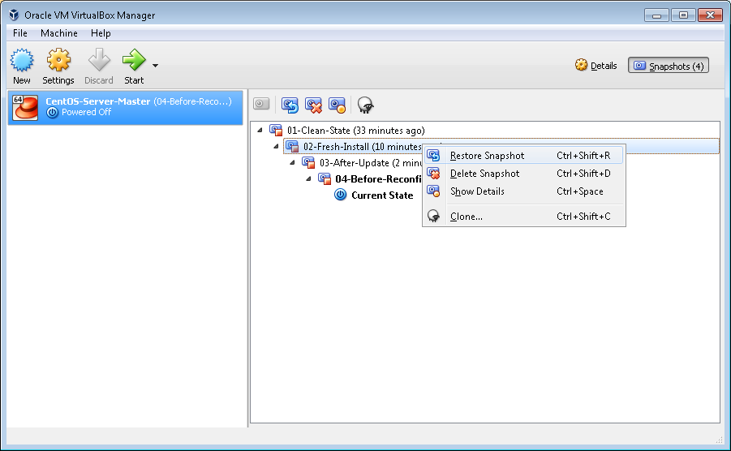
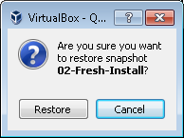
Solution: Track Changes in a VM
Restore from a snapshot

Slide 57
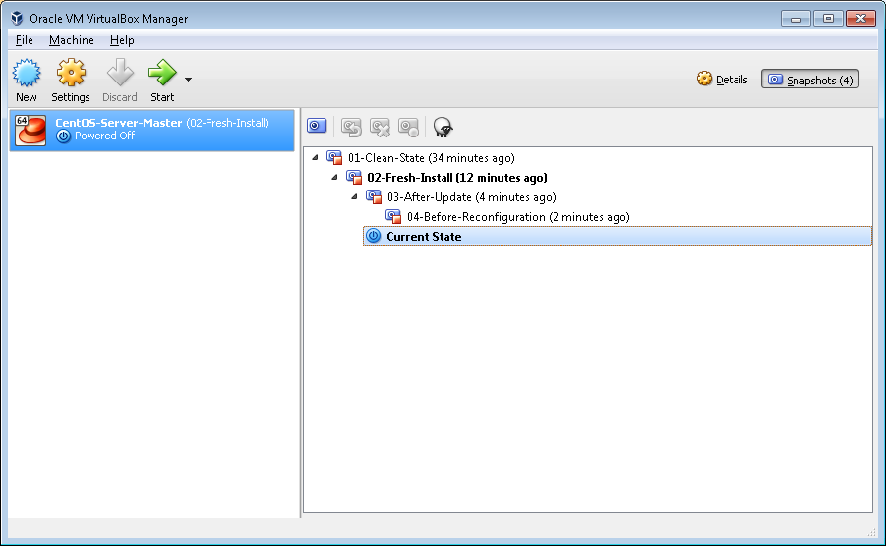
Solution: Track Changes in a VM
Current state has been switched

Slide 58
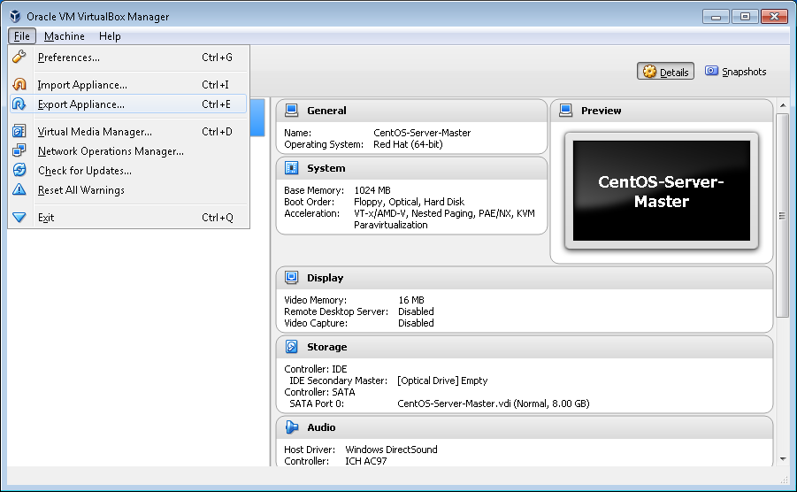
Problem: Import / Export Machines
Import / export or attach existing machine
Import machine
Export machine
Register existing machine

Slide 59
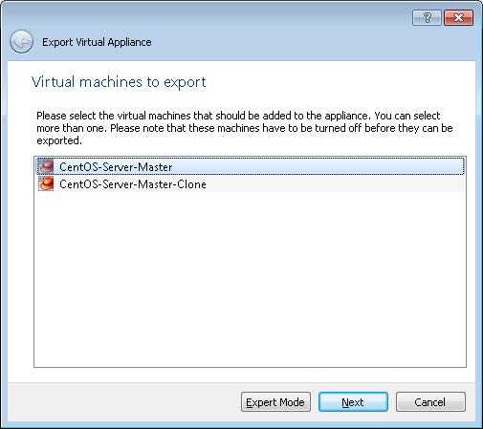
Solution: Import / Export Machines
Export a machine

Slide 60
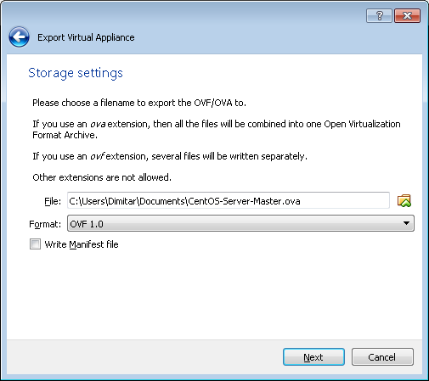
Solution: Import / Export Machines
Export type and place

Slide 61
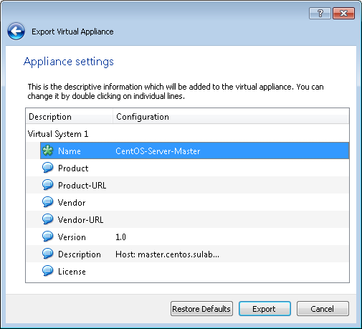
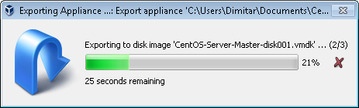
Solution: Import / Export Machines
Final settings

Slide 62
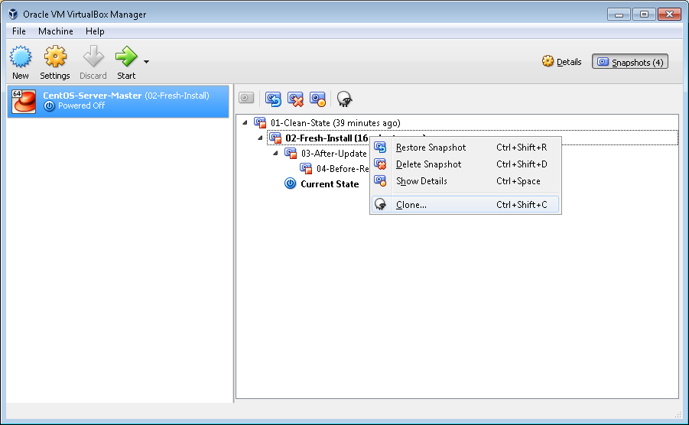
Problem: One Source – Multiple Targets
Create copies of a virtual machine
Stand-alone copies
Linked copies

Slide 63
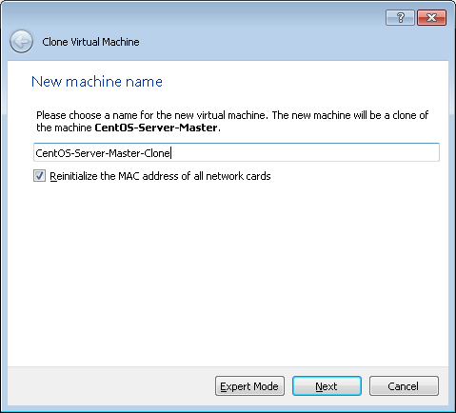
Solution: One Source – Multiple Targets
Set a name for the new machine

Slide 64
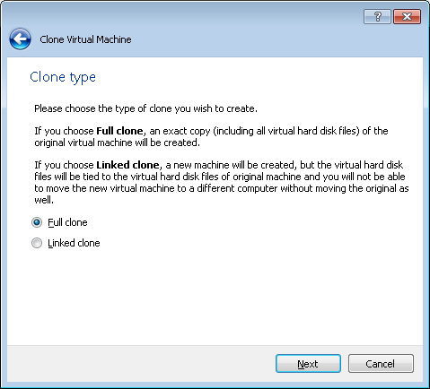
Solution: One Source – Multiple Targets
Chose a clone type

Slide 65
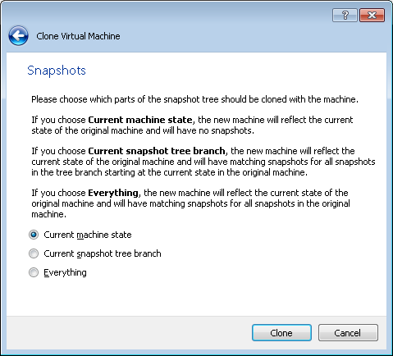
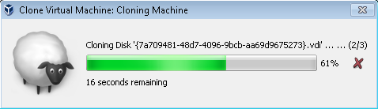
Solution: One Source – Multiple Targets
Chose which parts to clone

Slide 66
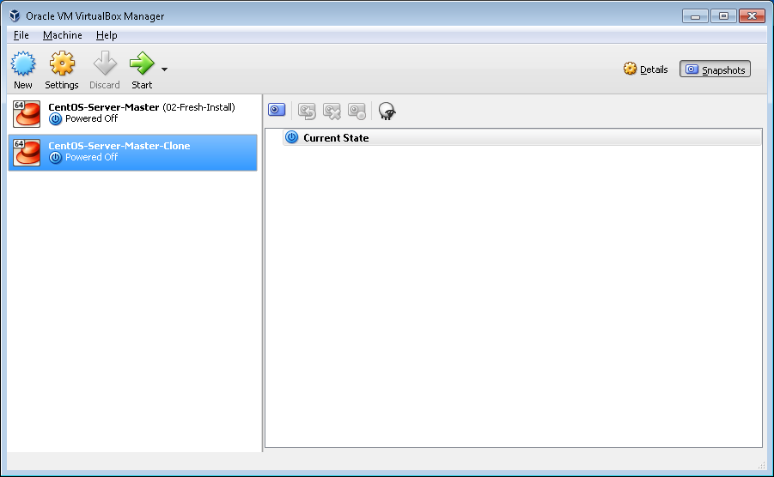
Solution: One Source – Multiple Targets
Result

Slide 67
Practice: VirtualBox and Linux
Live Demonstration in Class

Slide 68

Introduction to Linux Console
Definition and Types

Slide 69
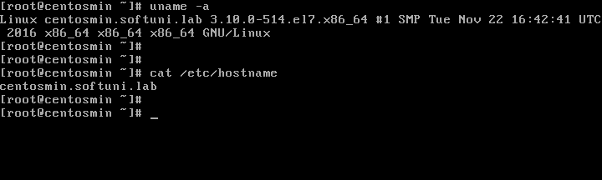
Shell Definition
Shell = Command line interface
It is a software that takes commands and passes them to the operating system
When in GUI, we use terminal emulators to interact with the shell

Slide 70
Shell Types
Plenty of shells
sh (Bourne Shell) and bash (Bourne Again Shell)
csh (C Shell) and tcsh (Enhanced C Shell)
ksh (Korn Shell)
zsh based on bash, ksh, and tcsh
Considering the invocation and interaction
Interactive and non-interactive
Login and non-login

Slide 71
Bash
Used by default on most Linux distributions
Offers strong scripting capabilities
Extensive knowledge base
Existing ready to use snippets and solutions

Slide 72
Bash Prompt
Prompt parts
Current user
Current directory
(~ = user's home)
Prompt end
(# - root, $ - regular)
[user@host ~]$ _
[root@host etc]# _
Name of the host

Slide 73

Environment Variables
Easily Access System Information

Slide 74
Environment Variables
An environment variable is a named object that contains data used by one or more applications
Display a variable's value
List environment variables
[user@host ~]$ echo $SHELL
/bin/bash
[user@host ~]$ printenv
HOSTNAME=host.softuni.lab
SHELL=/bin/bash
...

Slide 75
Environment Variables
Variable | Meaning
HOSTNAME | Name of the host
USER | Current user
HOME | Path to the home of the current user
PWD | Path to the current working directory
OLDPWD | Previous value of PWD
SHELL | Path to the user's preferred shell
PATH | List of directories to search for executable files
HISTFILE | Path to the history file
HISTSIZE | Size of the command history

Slide 76

Keyboard Shortcuts
Increase Your Productivity

Slide 77
Moving the Cursor
Key Combination | Action
<Ctrl>+<A> or <Home> | Move to the beginning of the line
<Ctrl>+<E> or <End> | Move to the end of the line
<Ctrl>+<B> or <Left> | Move left (backward) one character
<Alt>+<B> | Move left (backward) one word
<Ctrl>+<F> or <Right> | Move right (forward) one character
<Alt>+<F> | Move right (forward) one word

Slide 78
Control the Terminal
Key Combination | Action
<Ctrl>+<L> | Clears the screen
<Ctrl>+<C> | Interrupt a foreground running process
<Ctrl>+<Z> | Stop the execution of a process
<Ctrl>+<D> | Closes the terminal
<Tab> | Completes a command or path

Slide 79
Command Line
Key Combination | Action
<Ctrl>+<P> or <Up> | Previous command in the history
<Ctrl>+<N> or <Down> | Next command in the history
<Ctrl>+<D> or <Del> | Deletes the symbol under the cursor
<Alt>+<D> | Deletes the rest of the word
<Ctrl>+<H> or <Backsp> | Deletes the symbol before the cursor
<Ctrl>+<U> | Erase from cursor to beginning of line
<Ctrl>+<K> | Erase from cursor to end of line

Slide 80
Basic Commands
Getting to Know Your System

Slide 81
pwd
Purpose
Print name of the current/working directory
Syntax
Examples
pwd [-LP]
# Print current (home) directory of the logged user
[user@host ~]$ pwd

Slide 82
ls
Purpose
List directory contents
Syntax
Examples
ls [options] [files]
# List current directory including hidden files
[user@host ~]$ ls -a
# Show long listing for /etc directory
[user@host ~]$ ls -l /etc

Slide 83
cd
Purpose
Change the current directory
Syntax
Examples
cd [options] [directory]
# Go one level up
[user@host ~]$ cd ..
# Go to a folder using absolute path
[user@host ~]$ cd /etc

Slide 84
cat
Purpose
Concatenate file(s) and print on the standard output
Syntax
Examples
cat [options] [files]
# Show contents of bash history file
[user@host ~]$ cat .bash_history
# Show and number contents of a file
[user@host ~]$ cat -n /etc/os-release

Slide 85
date
Purpose
Print or set the system date and time
Syntax
Examples
date [[options] [+format]] | [[options] [date]]
# Show current date
[user@host ~]$ date
# Show current date with specific format applied
[user@host ~]$ date +%Y-%m-%d

Slide 86
cal
Purpose
Display a calendar
Syntax
Examples
cal [options]
# Display current month
[user@host ~]$ cal
# Display previous, current, and next month
[user@host ~]$ cal -3

Slide 87
hostname
Purpose
Get or set host's name
Syntax
Examples
hostname [options]
# Display host name
[user@host ~]$ hostname
# Display short host name
[user@host ~]$ hostname --short

Slide 88
hostnamectl
Purpose
Control the system hostname
Syntax
Examples
hostnamectl [options]
# Display host name
[user@host ~]$ hostnamectl
# Set host name
[user@host ~]$ hostnamectl set-hostname h1.home.lab

Slide 89
uname
Purpose
Print system information
Syntax
Examples
uname [options]
# Print kernel name
[user@host ~]$ uname
# Print full information about the system
[user@host ~]$ uname --all

Slide 90
uptime
Purpose
Tell how long the system has been running
Syntax
Examples
uptime [options]
# Print system uptime and average load
[user@host ~]$ uptime
# Print system uptime in pretty format*
[user@host ~]$ uptime --pretty

Slide 91
history
Purpose
Display or manipulate the history list
Syntax
Examples
history [options]
# Print history of executed commands
[user@host ~]$ history
# Clear history buffer and empty the history file
[user@host ~]$ history -cw

Slide 92
exit
Purpose
Exit the shell
Syntax
Examples
exit [status]
# Exit the shell with the status of last command
[user@host ~]$ exit
# Exit the shell with status of 100
[user@host ~]$ exit 100

Slide 93
logout
Purpose
Exit a login shell
Syntax
Examples
logout
# Exit a login shell
[user@host ~]$ logout

Slide 94
reboot*
Purpose
Reboot the system
Syntax
Examples
reboot [options] [arguments]
# Reboot the system as a regular user
[user@host ~]$ sudo reboot
# Reboot the system as root
[root@host ~]# reboot
* On some distributions or distribution versions a sudo prefix is required for regular users

Slide 95
poweroff*
Purpose
Power off the system
Syntax
Examples
poweroff [options]
# Power off the system as a regular user
[user@host ~]$ sudo poweroff
# Power off the system as root
[root@host ~]# poweroff
* On some distributions or distribution versions a sudo prefix is required for regular users

Slide 96
halt*
Purpose
Halt the machine
Syntax
Examples
halt [options]
# Halt the system
[root@host ~]# halt
# Power off the system
[root@host ~]# halt -p
* On some distributions or distribution versions a sudo prefix is required for regular users

Slide 97
shutdown*
Purpose
Halt, power-off or reboot the machine
Syntax
Examples
shutdown [options] [time] [wall]
# Turn off the machine in 10 minutes
[root@host ~]# shutdown -P +10
# Cancel pending shutdown
[root@host ~]# shutdown -c
* On some distributions or distribution versions a sudo prefix is required for regular users

Slide 98
wall
Purpose
Send message to everybody's terminal
Syntax
Examples
wall [-n] [message]
# Default format
[user@host ~]$ wall 'Please logout of the system'
# Print message without the default banner
[user@host ~]$ wall -n 'Logout now!'

Slide 99

Establish a Connection
Ways to Connect to the Console

Slide 100
Connection Options
Local connection
No network connection required
No additional software required
Remote connection
Requires network connection
Requires additional software on the guest (SSH service*)
Requires software on the host (PuTTY or other SSH client)
Allows us to copy and paste text and transfer files
* We will pay more attention on the topic in the coming modules

Slide 101
Practice: Shell in Action
Live Demonstration in Class

Slide 102
Summary
Linux is Everywhere
Linux is not an OS, but a Kernel
Kernel + Utilities = Distribution
There are Three Main Distribution Families
There are many types of Shell, but we will use bash
Basic Commands
pwd, ls, cd, etc.
Environment Variables
PATH, PWD, HOSTNAME, and etc.
…
…
…

Slide 103
Resources
CentOS download site
https://www.centos.org/download/
openSUSE Leap download site
https://software.opensuse.org/distributions/leap
Ubuntu download site
https://www.ubuntu.com/download/server

Slide 104
Questions?
Notes:
104

Slide 105











SoftUni Diamond Partners

Slide 106

License
This course (slides, examples, demos, exercises, homework, documents, videos and other assets) is copyrighted content
Unauthorized copy, reproduction or use is illegal
© SoftUni – https://about.softuni.bg/
© Software University – https://softuni.bg
Notes:
106

Slide 107
Trainings @ Software University (SoftUni)
Software University – High-Quality Education, Profession and Job for Software Developers
softuni.bg, about.softuni.bg
Software University Foundation
softuni.foundation
Software University @ Facebook
facebook.com/SoftwareUniversity
Software University Forums
forum.softuni.bg
Notes:
107

